Slide 1

WELCOME

Slide 2

Presented by :
Md Delowar Hossain
Assestent teacher
Amishapara government primary school
Sonimori ,Noakhali.

Slide 3

Class : one
Subject : English
Time :40 mins

Slide 4

Learning out come
Student will be able…….
To look, listen, and say with correct pronuncation .

Slide 5

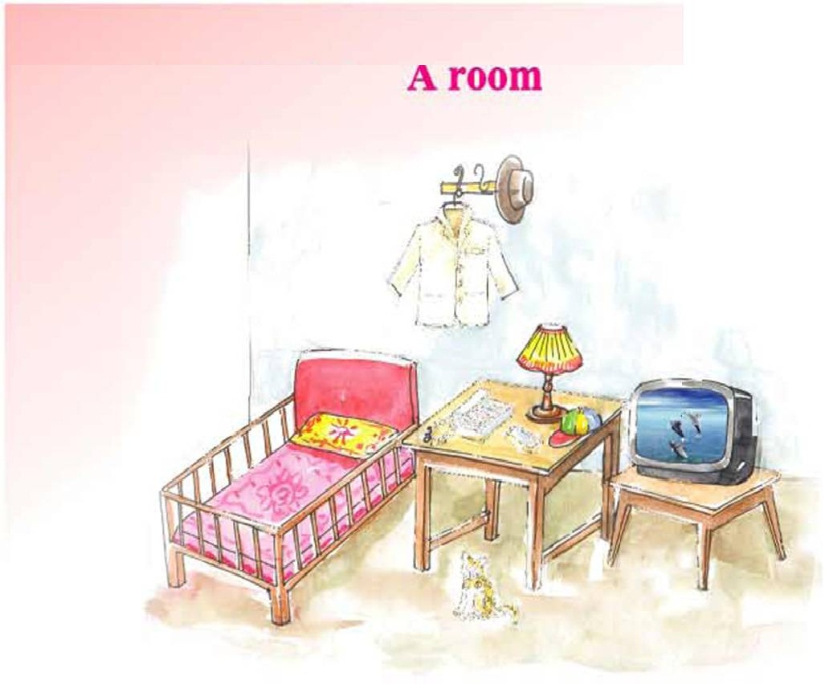
Look and say

Slide 6

Unit :5
Lesson : 3 (In the house)
Page :55

Slide 7


What’s this ?
Cap

Slide 8
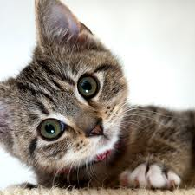
What’s this ?
Cat

Slide 9

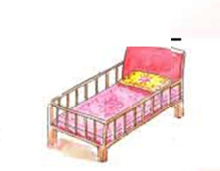
What’s this ?
Cot

Slide 10

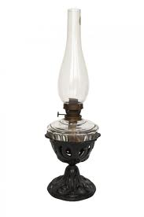
What’s this ?
Lamp

Slide 11
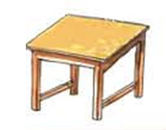
What’s this ?
Table

Slide 12


What’s this ?
Television

Slide 13

What’s this ?
Cat
Cot
Cap
Lamp
Table
Television

Slide 14
Matching
Cot
Lamp
Cap
Cat

Slide 15

THANK YOU

